Slide 1
Ch2-3 Memory Technology

Slide 2
Memory Hierarchy
The goal:To provide a memory system with cost most almost as low as the cheapest level of memory and speed almost as fast as the fastest level.
Processor
Control
Secondary
Storage
(Disk)
Second
Level
Cache
(SRAM)
Main
Memory
(DRAM)
Datapath
On-Chip
Cache
Registers
Compiler
Hardware
Speed:
Fastest
Operating System
Slowest
Size:
Smallest
Biggest
Cost:
Highest
Lowest

Slide 3
Main Memory Performance
Main memory---- the next level down in the hierarchy.
Main memory is usually made from DRAM while caches use SRAM.
Performance of main memory
Latency
harder to reduce latency ; Important for caches.
Bandwidth
easier to improve bandwidth with new organizations
Important for I/O.
Also for cache with second-level and larger block sizes.
The previous sections describe cache organization to reduce CPU-DRAM performance gap
This section we analyze techniques for organizing memory to improve bandwidth.

Slide 4
Why do I freaking care?
By it’s nature, DRAM isn’t built for speed
Reponse times dependent on capacitive circuit properties which get worse as density increases
DRAM process isn’t easy to integrate into CMOS process
DRAM is off chip
Connectors, wires, etc introduce slowness
IRAM(Internal RAM) efforts looking to integrating the two
Memory Architectures are designed to minimize impact of DRAM latency
Low Level: Memory chips
High Level memory designs.
You will pay $$$$$$ and then some $$$ for a good memory system.

Slide 5
Why do I freaking care?
1960-1985: Speed = ƒ(no. operations)
1990
Pipelined Execution & Fast Clock Rate
Out-of-Order execution
Superscalar Instruction Issue
1998: Speed = ƒ(non-cached memory accesses)
Superscalar, Out-of-Order machines hide L1 data cache miss (­5 clocks) but not L2 cache miss (­50 clocks)?

Slide 6

basic memory organization
First-level caches are often organized with a physical width of 1 word because most CPU accesses are that size
Assume
4 clock cycles to send the address
56 clock cycles for the access time per word
4 clock cycles to send a word of data
Block size is 4 words（现代CPU一般是8个字）
Every word is 8 bytes
The miss penalty:
4×(4+56+4)＝256 CLKs
Bandwidth :
4×8
1
Memory
＝
256
8
Notes:
CPU角度来看，一次逻辑上的cache访问最小粒度为4个字，但物理上访问粒度还是一个字

Slide 7
1st Technique for Higher Bandwidth Wider Main Memory
Amdahl’law suggested that memory capacity should grow linearly with CPU speed.
Retrospecting
Memory capacity grows four-fold every three years to supply this demand.
The CPU-DRAM performance gap is a problem, however, DRAM performance improvement is only about 5% per year.
Wider Main Memory
Doubling or quadrupling the width of the cache and the memory
It will therefore double or quadruple the memory bandwidth.

Slide 8
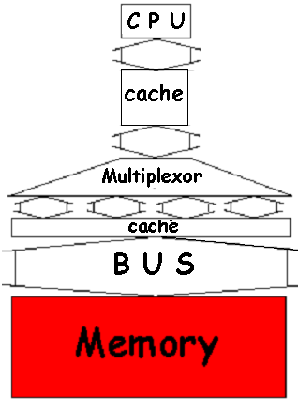
Many Words in Single bank
Widening memory:
Doubles /quadruples
Memory and Bandwidth
Disadvantages: bus
MUX required on critical path to allow word access
Increase minimum memory increment purchased by customer.
Complicates error correction
Memory

Slide 9
Perf. in the Technique
With a main memory width of 2 words
The miss penalty: 4words/Block
2×(4+56+4)＝128 CLKs
Bandwidth :
With a main memory width of 4 words
The miss penalty: 4words/Block
1×(4+56+4)＝64 CLKs
Bandwidth :
4×8
1
＝
128
4
4×8
1
＝
64
2

Slide 10
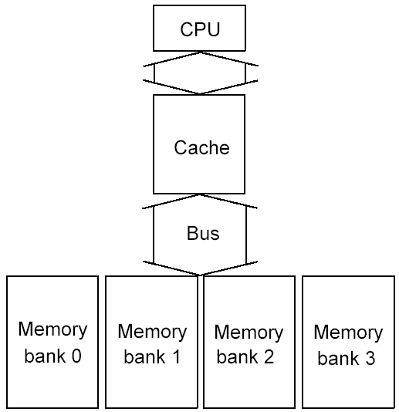
2nd Technique for Higher Bandwidth simple Interleaved Memory
Advantages:
Take advantage of the potential parallelism of having many chips in a memory system.
Such a memory organization optimizes sequential memory accesses, which is ideally matched with cache read misses.
Memory chips can be organized in banks to read or write multiple words at a time
The banks are often 1 word wide so that width of the bus and cache need NOT change.
Sending addresses to several banks permits them all to read simultaneously.
Memory

Slide 11
How Access Banks
Access Pattern without Interleaving:
CPU
Memory
D1 available
Start Access for D1
Start Access for D2
Memory
Bank 0
Access Pattern with 4-way Interleaving:
One memory control, shared address line and data bus
Memory
Bank 1
CPU
Memory
Bank 2
Memory
Bank 3
Access Bank 1
Access Bank 0
Access Bank 2
Access Bank 3
We can Access Bank 0 again
Notes:
Without interleaving, the frequency of our access will be limited by the DRAM cycle time.
With interleaving, that is having multiple banks of memory, we can access the memory much more frequently by accessing another bank while the last bank is finishing up its cycle.
For example, first we will access memory bank 0. Once we get the data from Bank 0, we will access Bank 1 while Bank 0 is still finishing up the rest of its DRAM cycle.
Ideally, with interleaving, how quickly we can perform memory access will be limited by the memory access time only.
Memory interleaving is one common techniques to improve memory performance.
+ 1 = 68 min. (Y:48)

Slide 12
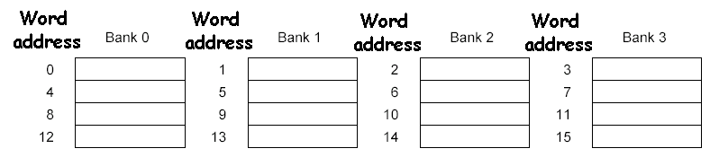
Performance of 4-way interleaved memory
With 4 banks Interleaved Memory
The miss penalty: 4words/Block
4+56 +(4 × 4)＝76
Bandwidth :
Four-way interleaved memory
4×8
＝
0.4
76
Parallel access
Optimizes sequential address access patterns

Slide 13
3rd Technique for Higher Bandwidth: Independent Memory Banks(多套地址、内存总线)
How many banks should be included? One metric, used in vector computers, is as follows:
Number of banks ≥ Number of clock cycles to access word in bank
对应2页前的图，避免顺序访问时存在等待memory back内部访问
Independent memory banks
The interleaved memory concept can be extended to remove all restrictions on memory access.
Independent memory controller was present for every bank.
Using separate address line and data bus
This allowed the interleaving of sequential access patterns.
给每个bank独立的地址与内存总线

Slide 14
Avoiding Memory Bank Conflicts
Assume: Memory banks 128, interleaved on a word basis, and execute following code:
int x[256][512];
for (j = 0; j < 512; j = j+1)
for (i = 0; i < 256; i = i+1)
x[i][j] = 2 * x[i][j];
How are Memory Bank Conflicts and does it solve ?
总是在访问同一个memory bank

Slide 15
4th Technique for Higher Bandwidth: Avoiding Memory Bank Conflicts
Conflicts Since the 512 is an even multiple of 128, all the elements of a column will be in the same memory bank and code will stall on data cache misses no matter how sophisticated a CPU or memory system.
Solutions: There are both software and hardware solutions
The compiler :
Loop interchange optimization to avoid accessing the same bank.
For the programmer or the compiler to expand the size of the array so that it is not a power of 2, thereby forcing the addresses above to go to different banks.
The hardware:
Using a prime number of memory banks 2^{n}-1 or 2^{n}+1
通过硬件与软件方法避免上一页提到的back冲突

Slide 16
Innovations into DRAM chips
Fewer chips in the same-sized memory system
2GB main memory
256 chips * (16M * 4 bits)
16 chips * ( 256M * 4 bits )
Shrinking number of chips in a standard configuration shrinks the importance of innovations at the board level.
一个存储单元（Cell）可以存放4bit，共有16M个存储单元
减少chip数量，降低板子设计的复杂度，这样可以不用针对板子做很多的创新设计及

Slide 17
Memory Technologies
Random Access Memories
DRAM: Dynamic Random Access Memory
High density, low power, cheap, slow
Dynamic: needs to be “refreshed” regularly
SRAM: Static Random Access Memory
Low density, high power, expensive, fast
Static: content will last “forever”(until lose power)
Two measures—access time and cycle time.
Access time ----- time between when a read is requested and when the desired word arrives,
Cycle time ----- minimum time between requests to memory.
One reason that cycle time is greater than access time is that the memory needs the address lines to be stable between accesses.

Slide 18
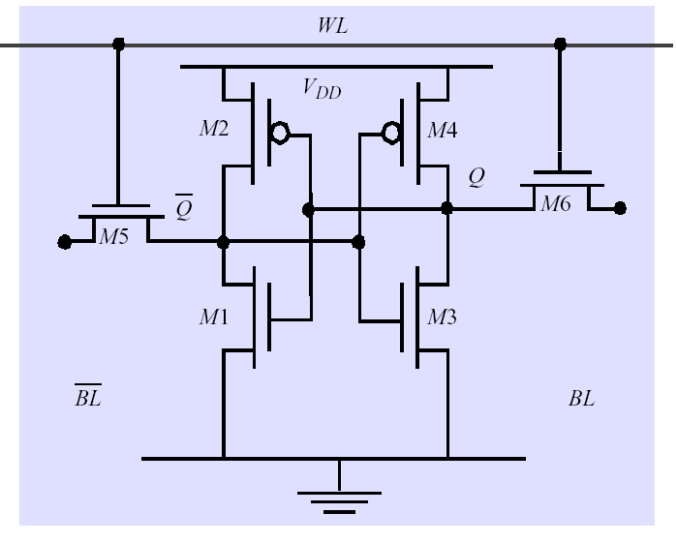
DRAM & SRAM
Dynamic RAM
simple transistor/capacitor pairs in high density form
Static RAM
Provides regular AND inverted outputs
Implemented in CMOS process
Word Line
C
. . .
Bit Line
Single Port 6-T SRAM Cell
Sense Amp

Slide 19
Main Memory Background
What gets used where?
Main memory is DRAM: you need it big, so you need it cheap
CPU cache memory is SRAM: you need it fast, so it’s more expensive, so it’s smaller than you would usually want due to resource limitations
Relative performance
Size: DRAM/SRAM: 4-8x bigger for DRAM
Cost/Cycle time: SRAM/DRAM: 8-16x faster, 8-16x expensive
Main Memory is DRAM: Dynamic Random Access Memory
Dynamic since needs to be refreshed periodically (8 ms, 1% time)
Addresses divided into 2 halves (Memory as a 2D matrix):
RAS or Row Access Strobe
CAS or Column Access Strobe

Slide 20
DRAM logical organization (64 Mbit)
Data in
Column Decoder
D
14
…
Sense
Amps & I/O
Data out
Address buffer
Q
Memory
Array
(16,384×16,384)
A0…A1
3
Row Decoder
Bit Line
…
Storage
Cell
Word Line
Square root of bits per RAS/CAS

Slide 21
DRAM Read Timing
左边时间短，功耗高，右边相反
Every DRAM access begins at:
The assertion of the RAS_L
2 ways to read: early or late v. CAS
RAS_L
CAS_L
WE_L
OE_L
A
256K x 8
DRAM
D
9
8
DRAM Read Cycle Time
RAS_L
CAS_L
A
Row Address
Col Address
Junk
Row Address
Col Address
Junk
WE_L
OE_L
D
High Z
Junk
Data Out
High Z
Data Out
Read Access
Time
Output Enable
Delay
Early Read Cycle: OE_L asserted before CAS_L
Late Read Cycle: OE_L asserted after CAS_L
Notes:
Similar to DRAM write, DRAM read can also be a Early read or a Late read.
In the Early Read Cycle, Output Enable is asserted before CAS is asserted so the data lines will contain valid data one Read access time after the CAS line has gone low.
In the Late Read cycle, Output Enable is asserted after CAS is asserted so the data will not be available on the data lines until one read access time after OE is asserted.
Once again, notice that the RAS line has to remain asserted during the entire time. The DRAM read cycle time is defined as the time between the two RAS pulse.
Notice that the DRAM read cycle time is much longer than the read access time.
Q: RAS & CAS at same time? Yes, both must be low
+2 = 65 min. (Y:45)

Slide 22
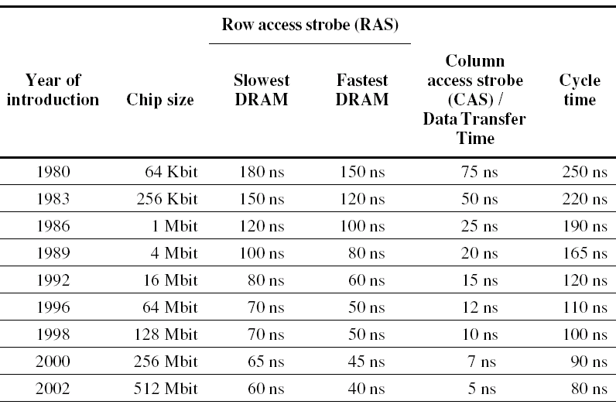
Times of fast and slow DRAMs with each generation.

Slide 23
Times of fast and slow DRAMs with each generation.

Slide 24
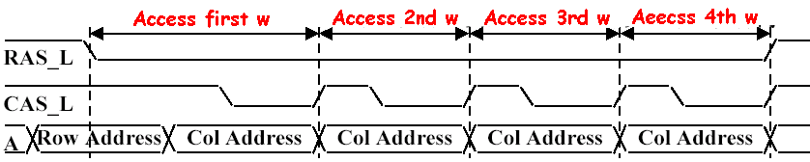
1st Improving DRAM Performance Fast Page Mode DRAM (FPM)
Timing signals that allow repeated accesses to the row buffer (page) without another row access time
Such a buffer comes naturally, as each array will buffer 1024 to 2048 bits for each access.
Page: All bits on the same ROW (Spatial Locality)
Don’t need to wait for wordline to recharge
Toggle CAS with new column address

Slide 25
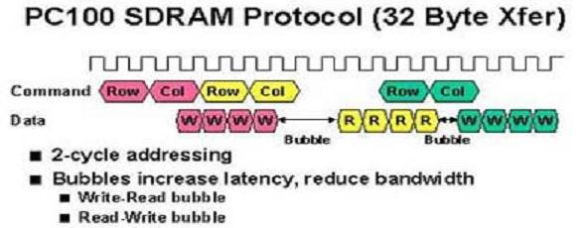
2nd Improving DRAM Performance Synchronous DRAM
conventional DRAMs have an asynchronous interface to the memory controller, and hence every transfer involves overhead to synchronize with the controller.
The solution was to add a clock signal to the DRAM interface, so that the repeated transfers would not bear that overhead.
Data output is in bursts w/ each element clocked
时钟是用来同步的
一个字是8字节

Slide 26
3rd Improving DRAM Performance DDR--Double data rate
On both the rising edge and falling edge of the DRAM clock signal, DRAM innovation to increase bandwidth is to transfer data,
thereby doubling the peak data rate.
2.5V
1.8v
1.5v

Slide 27
4rd Improving DRAM Performance New DRAM Interface: RAMBUS (RDRAM)
a type of synchronous dynamic RAM, designed by the Rambus Corporation.
Each chip has interleaved memory and a high speed interface.
Protocol based RAM w/ narrow (16-bit) bus
High clock rate (400 Mhz), but long latency
Pipelined operation
Multiple arrays w/ data transferred on both edges of clock
The first generation RAMBUS interface dropped RAS/CAS, replacing it with a bus that allows other accesses over the bus between the sending of the address and return of the data. It is typically called RDRAM.
The second generation RAMBUS interface include a separate row- and column-command buses instead of the conventional multiplexing; and a much more sophisticated controller on chip. Because of the separation of data, row, and column buses, three transactions can be performed simultaneously. called Direct RDRAM or DRDRAM

Slide 28
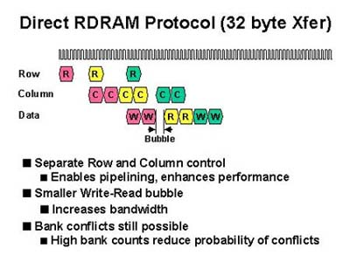
RDRAM Timing

Slide 29
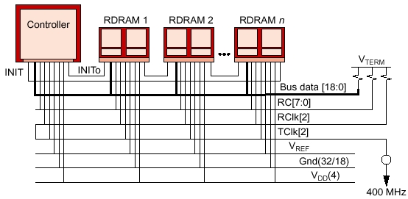
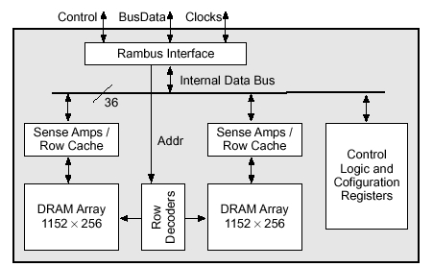
RAMBUS (RDRAM)
RDRAM Memory System
RAMBUS Bank

Slide 30
Comparing RAMBUS and DDR SDRAM
Since the most computers use memory in DIMM packages, which are typically at least 64-bits wide, the DIMM memory bandwidth is closer to what RAMBUS provides than you might expect when just comparing DRAM chips.
Caution that performance of cache are based in part on latency to the first byte and in part on the bandwidth to deliver the rest of the bytes in the block.
Although these innovations help with the latter case, none help with latency.
Amdahl’s Law reminds us of the limits of accelerating one piece of the problem while ignoring another part.

Slide 31
Summery
Memory organization
Wider memory
Simple interleaved memory
Independent memory banks
Avoiding Memory Bank Conflicts
Memory chip
Fast Page Mode DRAM
Synchronize DRAM
Double Date Rate
RDRAM

Slide 32
5.10 virtual Memory
What is virtual memory?
Technique that allows execution of a program that
can reside in discontiguous memory locations
does not have to completely reside in memory
Allows the computer to “fake” a program into believing that its
memory is contiguous
memory space is larger than physical memory, Provides illusion of very large memory
Why is VM important?
Cheap - no longer have to buy lots of RAM
Removes burden of memory resource management from the programmer
Enables multiprogramming, time-sharing, protection

Slide 33
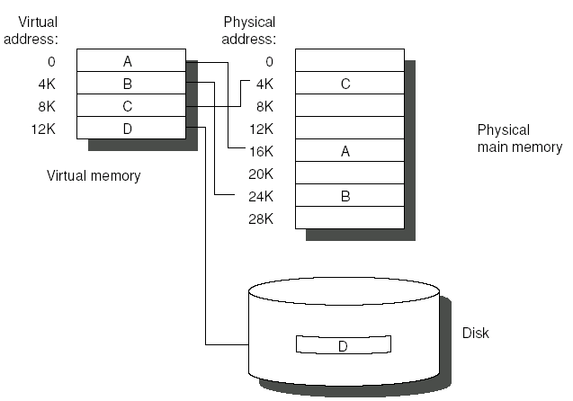
Advantages
Main memory (physical memory) can act as a cache for the secondary storage (disk)
illusion of having more and contiguous physical memory
program relocation by “pages” or “segment”
protection in multiprogramming
Virtual Address : address used by the programmer
Virtual Address Space: collection of such addresses
Memory Address: address of word in physical memory also known as “physical address” or “real address”

Slide 34
How Does VM Work
Two memory “spaces”
Virtual memory space - what the program “sees”
Physical memory space - what the program runs in (size of RAM)
On program startup
OS copies program into RAM
If there is not enough RAM, OS stops copying program & starts running the program with some portion of the program loaded in RAM
When the program touches a part of the program not in physical memory, OS copies that part of the program from disk into RAM
In order to copy some of the program from disk to RAM, OS must evict parts of the program already in RAM
OS copies the evicted parts of the program back to disk if the pages are dirty (ie, if they have been written into, and changed)

Slide 35
Memory Hierarchy Parameters for Virtual Memory.
Terms are different
Block ----Page or segment
Miss ----page fault or address fault
Memory mapping or address translation ----With virtual memory, the CPU produces virtual addresses that are translated by a combination of hardware and software to physical addresses, which access main memory.------ Operating system translate
The two memory-hierarchy levels controlled by virtual memory are DRAMs and magnetic disks.

Slide 36
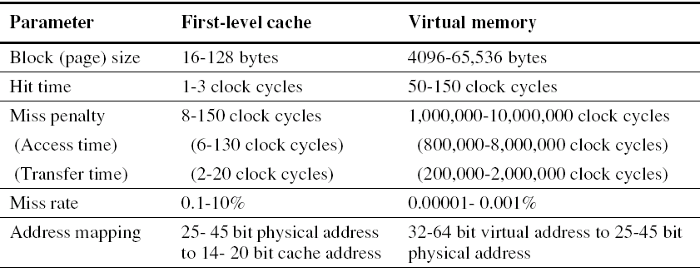
Cache vs. VM

Slide 37
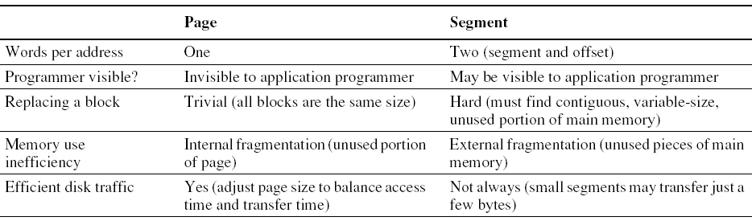
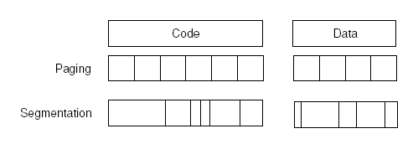
Paging vs. Segmentation
Virtual memory systems can be categorized into two classes
Pages---- fixed-size blocks,
segments---- variable-size blocks

Slide 38
Four Memory Hierarchy Questions Revisited
Q1: Where can a block be placed in main memory?
The high miss penalty
Quite high
access to a rotating magnetic storage device
Must be lower miss rates
choosing a simpler placement algorithm
operating systems designers normally pick lower miss rates because of the exorbitant miss penalty.
Fully associative strategy.
Thus, operating systems allow blocks to be placed anywhere in main memory.

Slide 39
Q2: How is a block found if it is in main memory?
Both paging and segmentation data structure table
The data structure contains the physical address of the block.
That is indexed by the page or segment number
For segmentation:
The offset is added to the segment’s physical address to obtain the final physical address.
For paging:
the offset is simply concatenated to this physical page address
The size of the table
The number of pages in the virtual address space.
Assume: 32-bit virtual address, 4-KB pages, and 4 bytes per page table entry; the size of the page table:

Slide 40
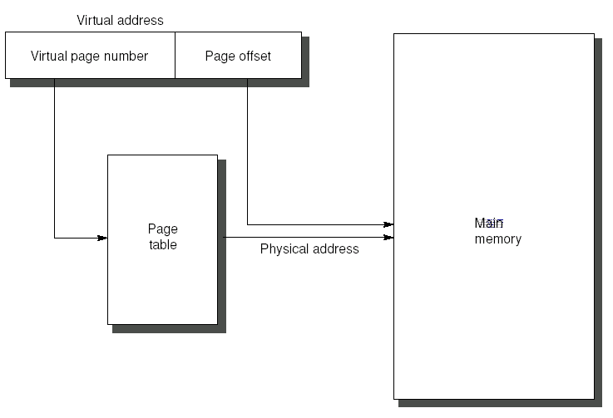
How to find a block is in memory
2³²
×2² ＝2²²B＝4 MB
2¹²
To reduce the size table
-Apply a hashing function to the virtual address.
-The hash allows the data structure to be the length of the number of physical pages in main memory. Such a structure is called an inverted page table.
To reduce address translation time
-Computers use a cache dedicated to these address translations, called a translation look-aside buffer, or simply translation buffer.

Slide 41
Q3: Which block should be replaced on a virtual memory miss?
For minimizing page faults
Almost all operating systems try to replace the least-recently used (LRU) block
because if the past predicts the future, that is the one less likely to be needed.
Mechanism
many processors provide a use bit or reference bit
which is logically set whenever a page is accessed.
The operating system periodically clears the use bits and later records them
By keeping track in this way, the operating system can select a page that is among the least-recently referenced.

Slide 42
Q4: What happens on a write?
write strategy
The level below main memory contains rotating magnetic disks that take millions of clock cycles to access.
Thus, the write strategy is always write back.
Dirty bit
cost of an unnecessary access Disk is so high, it allows blocks to be written to disk only if they have been altered since being read from the disk.

Slide 43
Techniques for Fast Address Translation
Access frequently with obtaining one data This cost is far too dear
Page tables are usually so large that they are stored in main memory, and sometimes paged themselves.
Paging means that every memory access logically takes at least twice as long, with one memory access to obtain the physical address and a second access to get the data.
translation look-aside buffer----TLB
if the accesses have locality, then the address translations for the accesses must also have locality.
By keeping these address translations in a special cache, a memory access rarely requires a second access to translate the data.
This special address translation cache is referred to as a translation look-aside buffer or TLB, also called a translation buffer or TB.

Slide 44
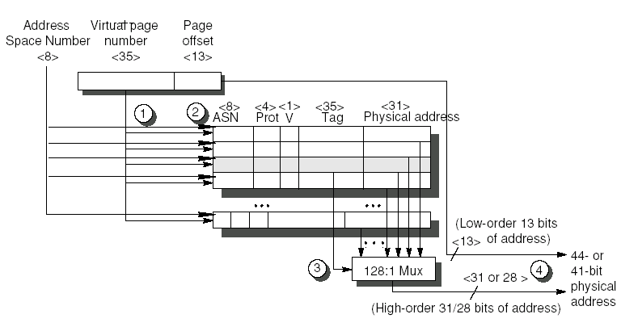
Operation of the Alpha 21264 data TLB during address translation
ASN起到了类似于PID的作用
TLB each entry has an 8-bit Address Space Number ( ASN)
If the context switching returns to the process with the same ASN, it can still match the TLB.
Thus, the process ASN and the page table entry (PTE) ASN must also match for a valid tag ( same role as a Process PID number )

Slide 45
Steps for address translation
steps 1 and 2:
The translation begins by sending the virtual address to all tags. Of course, the tag must be marked valid to allow a match.
At the same time, the type of memory access is checked for a violation (in step 2) against protection information in the TLB.
Sept 3: The matching tag sends the corresponding physical address(page) through effectively a 128:1 multiplexor
Sept 4: The page offset is then combined with the physical page frame to form a full
physical address The address size is 44 or 41 bits depending on a physical address mode bit

Slide 46
Balancing smaller and larger
Balancing larger page size versus smaller size.
The size of the page table is inversely proportional to the page size;
memory (or other resources used for the memory map) can therefore be saved by making the pages bigger.
A larger page size can allow larger caches with fast cache hit times.
Transferring larger pages to or from secondary storage, possibly over a network, is more efficient than transferring smaller pages.
The number of TLB entries are restricted, so a larger page size means that more memory can be mapped efficiently, thereby reducing the number of TLB misses.

Slide 47
Selecting a Page Size
Smaller page size
Be conserving storage.
A small page size will result in less wasted storage when a contiguous region of virtual memory is not equal in size to a multiple of the page size.
Internal fragmentation----Unused memory in a page
larger page size
The page sizes become very large (more than 32 KB), lots of storage (both main and secondary) may be wasted
As well as I/O bandwidth.
A final concern is process start-up time
many processes are small, so a large page size would lengthen the time to invoke a process

Slide 48
Multiple page size
To support multiple page sizes
It is for the number of TLB entries that recent microprocessors have decided to support multiple page sizes
For some programs, TLB misses can be as significant on CPI as the cache misses.

Slide 49
Summary of Virtual Memory and Caches
Hypothetical parameter
Virtual address: 64-bit
Physical address: 41 bit
Memory organization: with two levels of cache
This L1 cache is virtually indexed, physically tagged（虚拟地址查找TLB和cache，cache内用物理地址做比较） since both the cache size and the page size are 8 KB.
The L2 cache is 4 MB. The block size for both is 64 bytes.

Slide 50
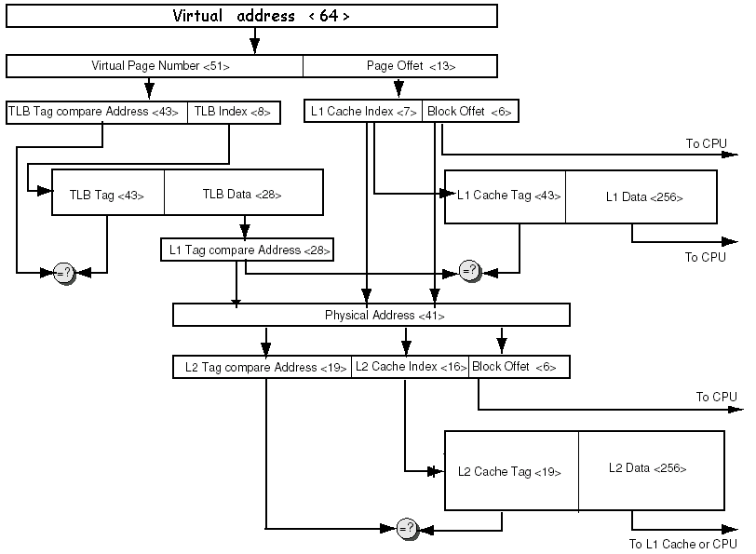
<28>

Slide 51
Protection and Examples of Virtual Memory
Multiprogramming and process.
computer would be shared by several programs running concurrently, which led to new demands for protection and sharing among programs.
process switch or context switch.
Giving the illusion that all users have their own computers.
Time-sharing is a variation of multiprogramming that shares the CPU and memory with several interactive users at the same time
Thus, at any instant it must be possible to switch from one process to another.
Protection
VM is often used to protect one program from others in the system.
Protection mechanisms must have hardware and software support.
The computer designer must ensure that the CPU portion of the process state can be saved and restored.
The operating system designer must guarantee that processes do not interfere with each others’ computations.

Slide 52
Protecting Processes
Protecting with Base & bounds
A pair of registers with address range that checks every address that accesses memory
Each reference must fall between two addresses, given by the base & bound registers.
Base and Bound ----Address limits
An address is valid if Base ≤ Address ≤ Bound
Or (Base + Address) ≤ Bound
Change registers values
User processes cannot be allowed to change these registers
but the OS must be able to do so on a process switch.

Slide 53
Three more Responsibilities
Computer designer has three more responsibilities in helping the operating system designer protect processes from each other:
Provide at least two modes
indicating whether the running process is a user process
or an operating system process. Called a kernel process, a supervisor process, or an executive process.
2. Provide a portion of the CPU state
that a user process can use but not write.
This state includes
The base/bound registers,
a user/supervisor mode bit(s),
And the exception enable/disable bit.
Users are prevented from writing this state

Slide 54
Three more Responsibilities
3. Provide mechanisms whereby the CPU can go from user mode to supervisor mode and vice versa.
The first direction ----typically accomplished by a system call, implemented as a special instruction that transfers control to a dedicated location in supervisor code space.
The PC is saved from the point of the system call
The CPU is placed in supervisor mode.
The second direction ---- return to user mode
like a subroutine return that restores the previous user/supervisor mode.

Slide 55
Protecting with Another Idea
Fine-grained Protecting
Virtual memory offers a more fine-grained protection
The CPU address must be mapped from virtual to physical address.
This mapping provides the opportunity for the hardware to check further for errors in the program or to protect processes from each other.
How:
add permission flags to each page or segment.
For example, since few programs today intentionally modify their own code, an operating system can detect accidental writes to code by offering read-only protection to pages.
This page-level protection can be extended by adding user/kernel protection to prevent a user program from trying to access pages that belong to the kernel.

Slide 56
Protecting with Another Idea-2
Page tables Protecting
Processes are thus protected from one another by having their own page tables, each pointing to distinct pages of memory.
Obviously, user programs must be prevented from modifying their page tables or protection would be circumvented.
Rings Protecting
Rings added to the CPU protection structure expand memory access protection from two levels (user and kernel) to many more.
Top secret→ secret → confidential → unclassified
Concentric rings of security levels allow the most trusted let the second most trusted to access everything except the innermost level, and so on.
The “civilian” programs are the least trusted and, hence, have the most limited range of accesses.

Slide 57
Protecting with Another Idea-3
Key Protecting
Restricting the freedom given a program in the inner sanctum requires a new classification system.
Keys and Locks
A program can’t unlock access to the data unless it has the key.
For these keys, or capabilities, to be useful, the hardware and operating system must be able to explicitly pass them from one program to another without

Slide 58
Segmented VM example : P476 Protection in the intel Pentium
Double the traditional two-level protection model
Innemost (0) to outermost (3)
Divides the address space, allowing both the OS and user access to the full space.
Global address space: shared by all processes
Local address space: unique to each process
Descriptor table ( item: Segment descriptor)
Present bit ~ valid bit
Base field ~ page frame address
Access bit ~ reference bit
Attributes field ~ valid operation and protection level
Special segment descriptor: Call gate

Slide 59
5.12 Crosscutting Issues（跨领域问题）: the design of memory hierarchy
Superscalar CPU →
Cache should provide peak bandwidth that matches CPU demand
the memory hierarchy must also be nonblocking
Speculative Execution→
Memory system must identify speculatively executed instructions and conditionally executed instructions and suppress corresponding exception
Nonb locking caches
Combine Instruction cache with IF and ID
Trace cache, branch prediction with IF,
Embedded Computer Cache and Real-time performance
A portion of the cache can be “locked down” under program control.
Embedded computer Caches and power
Way prediction to only power half of the address-checking hardware for two-way set-associate cache.

Slide 60
I/O and consistency of cache data
Solution of Situation a
Write through to avoid incoherent of b
Write through is usually found in 1-level cache backed by a write –back 2-level cache.
Solution of Situation b
Software: Guarantee no blocks of the I/O buffer are in the cache
Mark buffered blocks as noncachable
Flushes the buffer addresses from the cache before the input occur
Hardware: check the I/O address on input to see if they are in the cache.
A duplicate set of tags may be used
Cache
Memory

Slide 61
Example: Alpha 21264 Memory Hierarchy
The 21264 is an out-of-order execution processor
fetches up to 4 instructions per clock cycle and executes up to 6 instructions per clock cycle.
virtual address
48-bit virtual address and a 44-bit physical address
/ 43-bit virtual address and 41-bit physical;
In either case, Alpha halves the physical address space, with the lower half for memory addresses and the upper half for I/O addresses.
when the Alpha is turned on.
Hardware on the chip loads the instruction cache serially from an external PROM. (16K instructions)
The same serial interface (and PROM) also loads configuration information that specifies L2 cache speed/timing, system port speed/timing, and much other information necessary

Slide 62
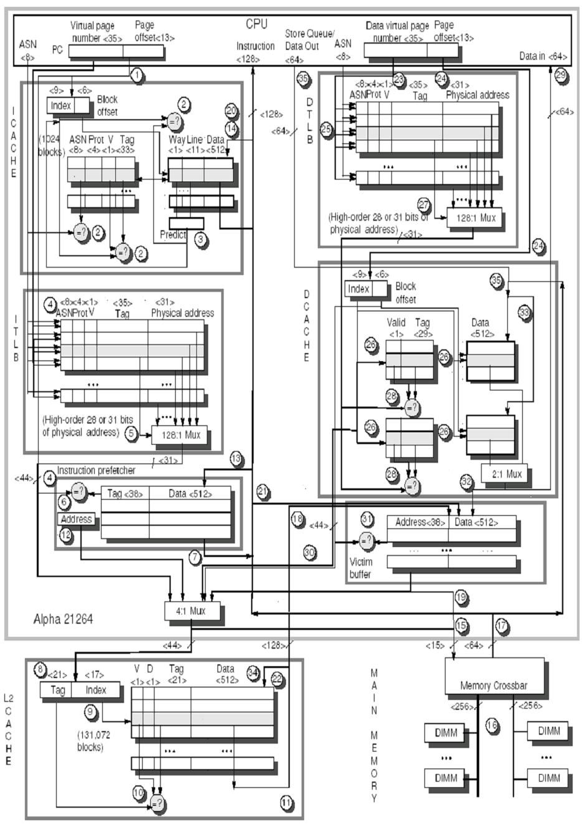
与前面的图类似，这里把指令cache与数据cache分离

